Slide 1
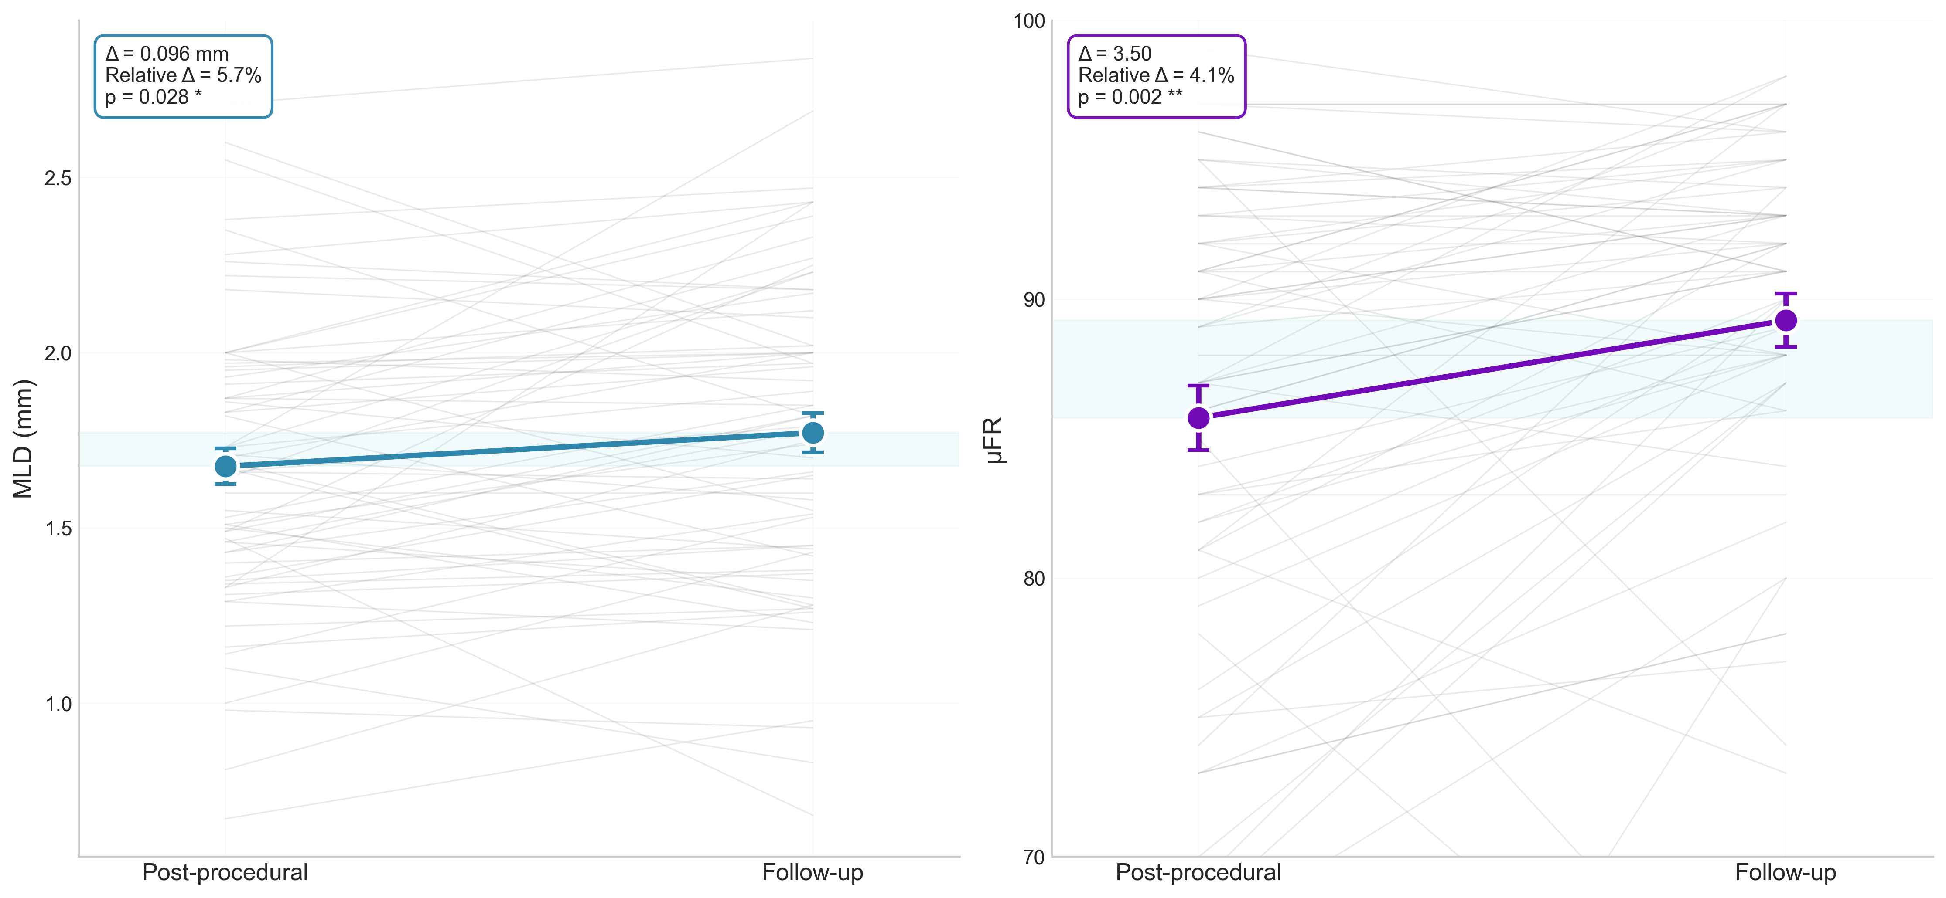
Late functional gain
Late lumen enlargement
A
B

Slide 2
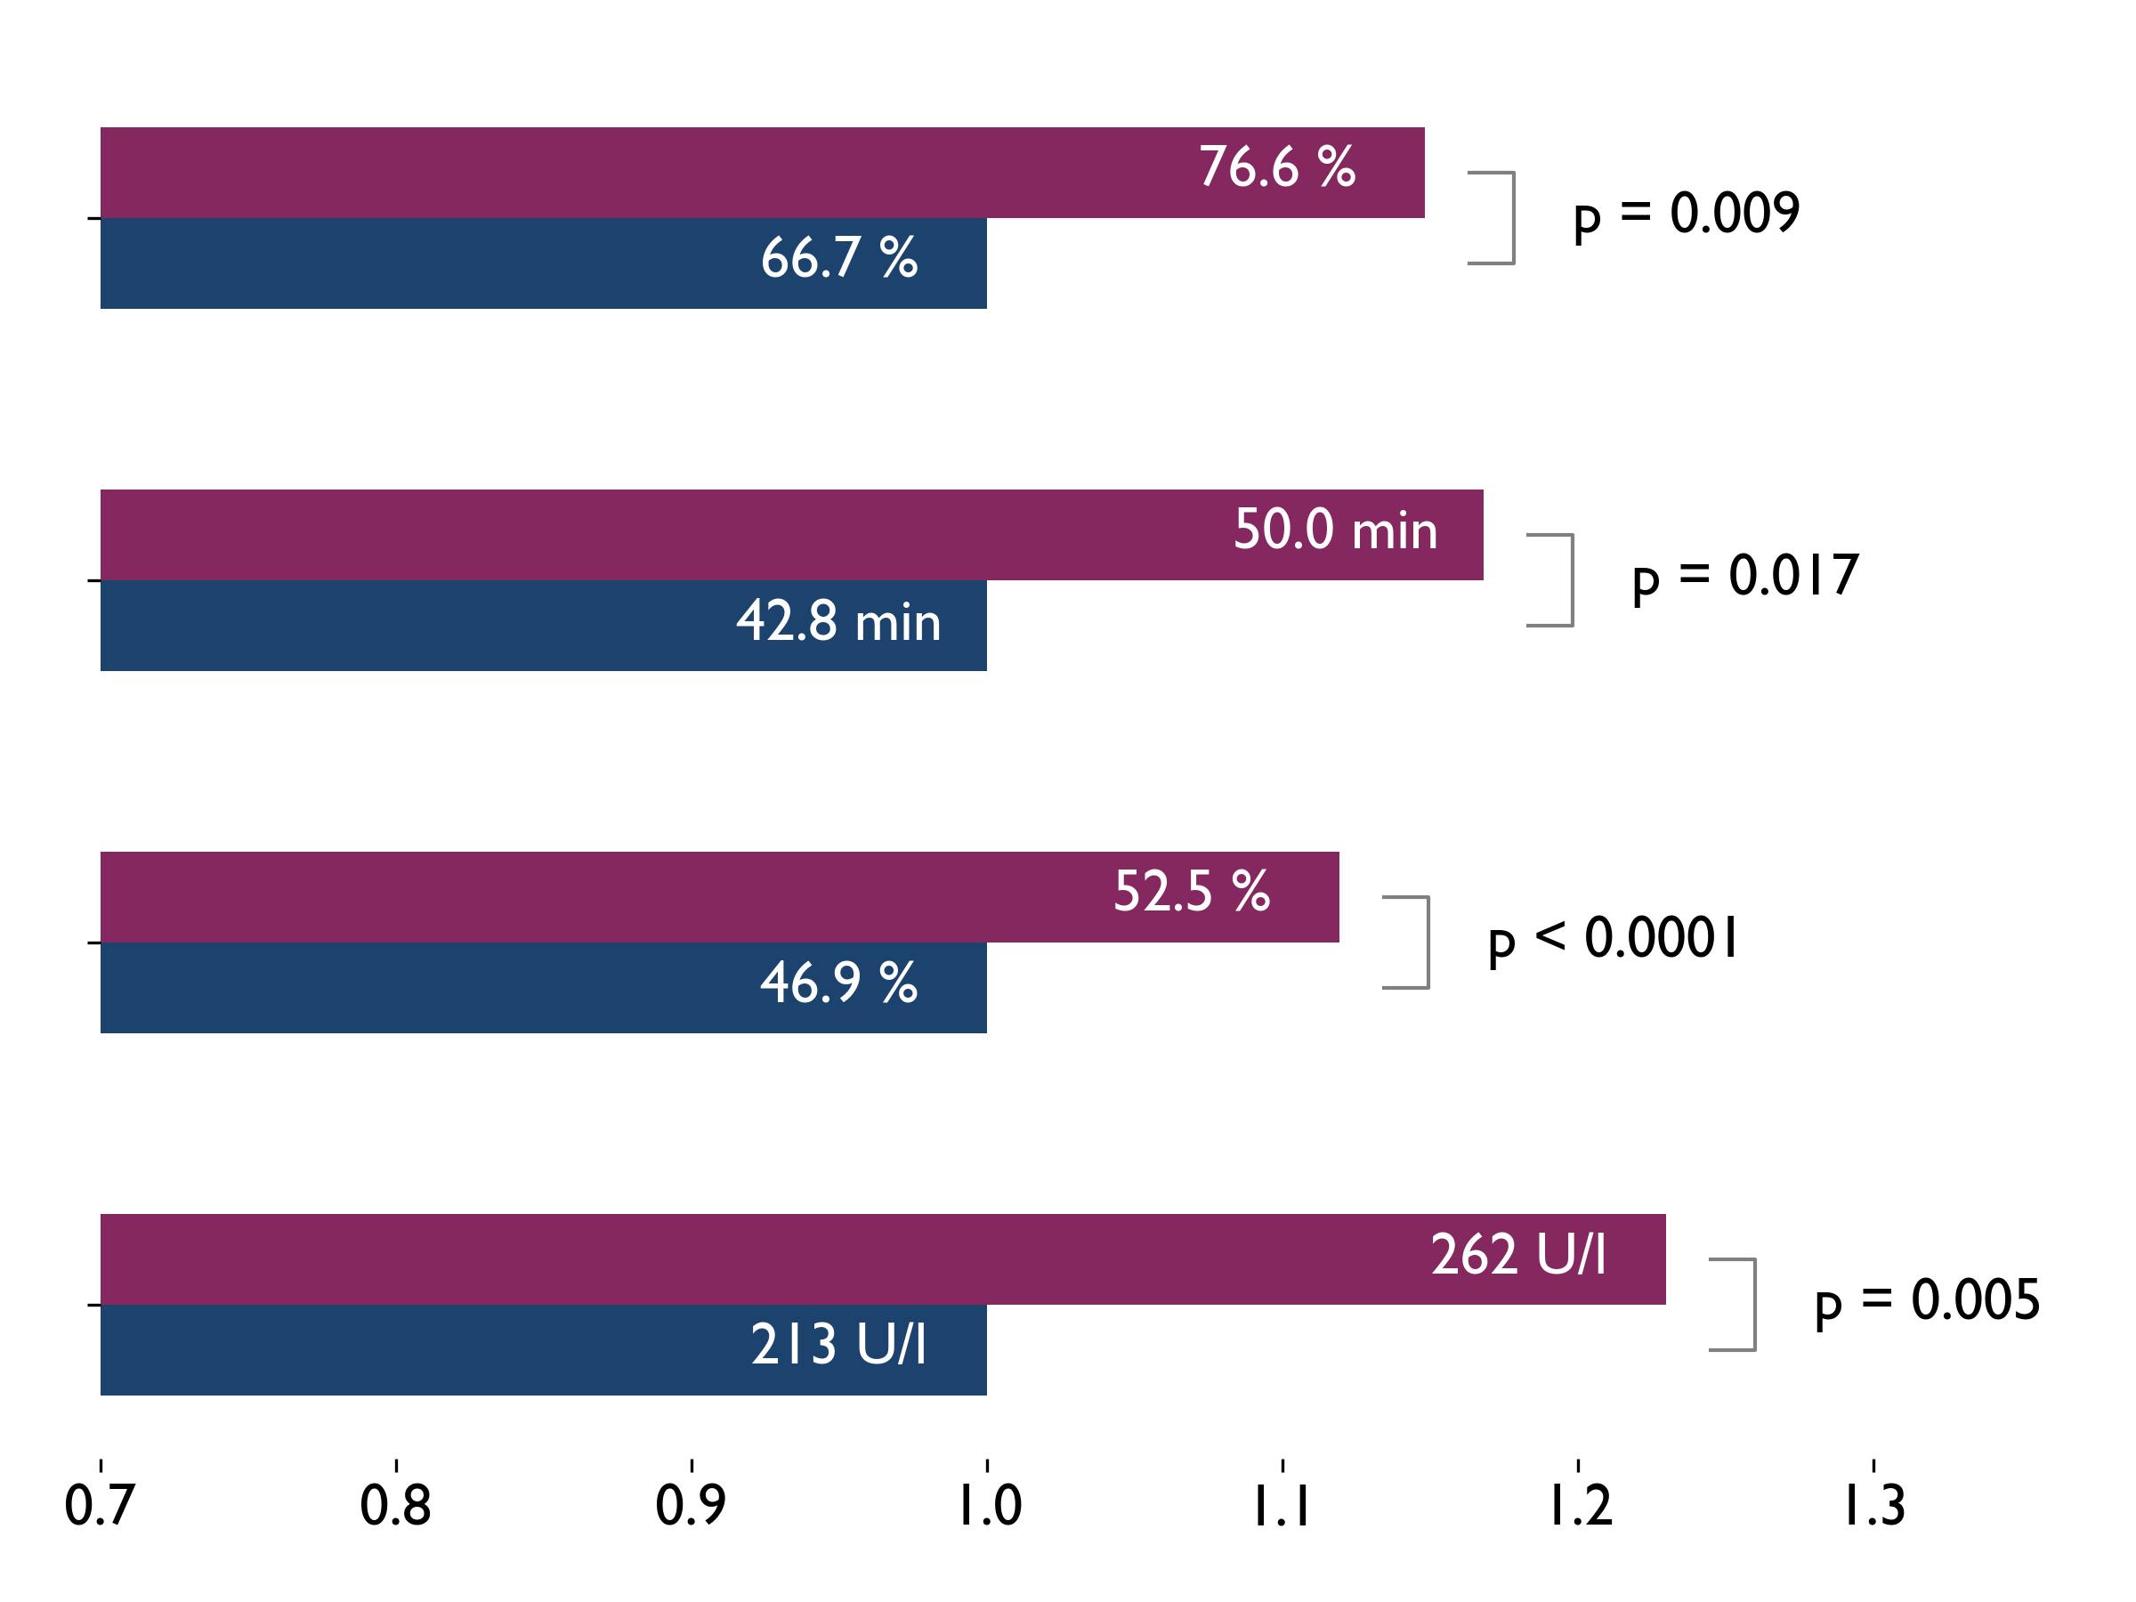


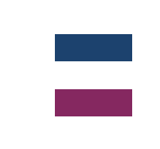



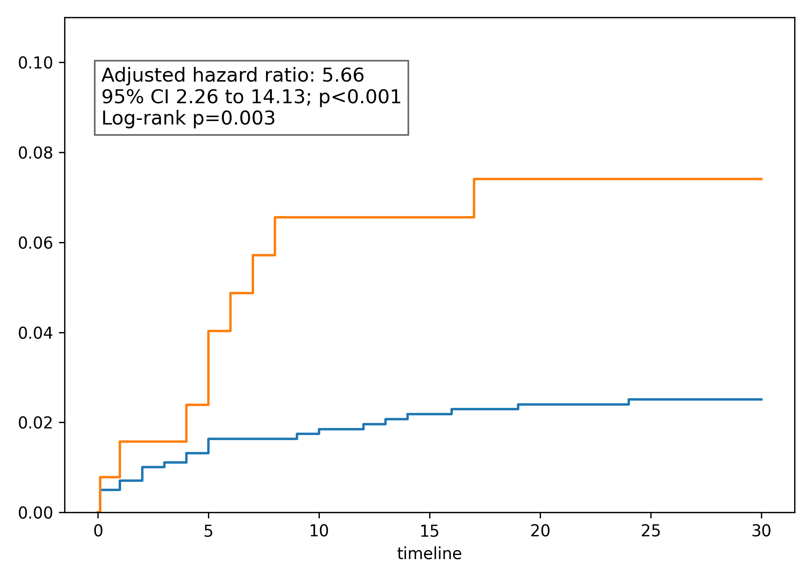

Diagnostic Delays, Cardiac Rehabilitation and Mortality After LCx-Related STEMI
Do patients with an LCx culprit STEMI receive poorer management and less cardiac rehabilitation (CR) ?
1205 patients
Time to diagnosis
LCx culprit:
(i) was the strongest predictor of CR underuse
Presenting with STEMI
Grouped by LCx vs LAD + RCA culprit
LVEF
Non-LCx
LCx
OR 0.57 (p=0.005)
Non-LCx
(n=1039)
LCx
(n = 166)
vs.
(ii) was associated with increased 2-year CV death in-hospital survivors
Infract size
Outcomes
HR 2.85 (p=0.002)
CV death and participation in CR
First medical contact (FMC) to STEMI diagnosis, Infarct size (peak CK-MB), LVEF
Relative to Non-LCx
Adjustment with CR only reduced OR and lost significances
C
30-day CV death
HR 1.32 (p=0.38)
LCx
Conclusion
Statistical analysis
LCx occlusion in STEMI delays diagnosis, leaded to larger infarcts masked by preserved LVEF, and reduced CR referral
2-year CV death was higher likely driven by the underuse of CR
Survival endpoints: adjusted odds ratio (exact logistic regression) and hazard ratio (Cox regression)
Continuous endpoints: GLM
All adjusted with multiple covariate
Cumulative probability of event
Non-LCx
Days after STEMI

Slide 3
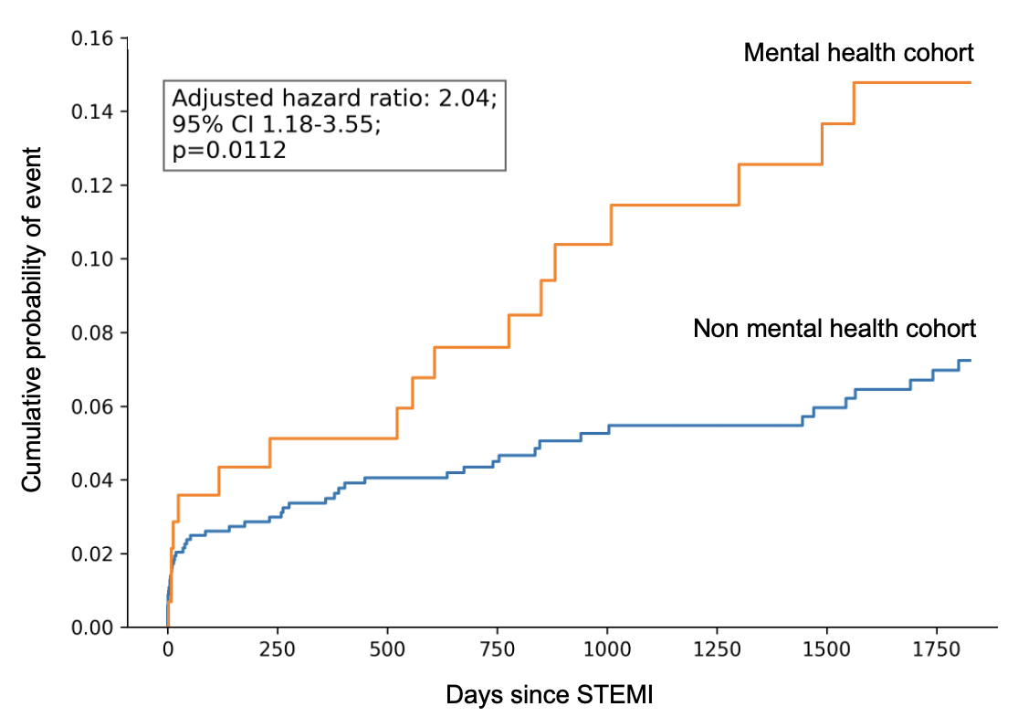

Disparities in STEMI diagnosis and management among patients with mental health conditions
Do patients with STEMI with a documented mental health condition (MHC) in EHR have longer treatment delays?
1208 patients
Results
5-year CV death by MHC status
Presenting with STEMI
Grouped by the presence of a MHC in EHR at presentation
FMC-to-diagnosis
Mental health cohort
(n = 147)
Non
mental health cohort
(n = 1061)
+16.4 min
(95% CI +4.19 to +28.68
p=0.009)
Outcomes
FMC-to-balloon
First medical contact (FMC) to STEMI diagnosis and FMC-to-balloon
Infarct size (peak CK-MB), 30-day and 5-year MACCE and CV death
+18.6 minutes
(95% CI +4.86 to +32.39; p=0.008)
Analysis
Infarct size
Conclusion
A documented MHC in EHR was linked with significant delays in STEMI diagnosis leading to greater infract size.
MHC are associated with a greater long-term risk of CV death.
Generalized linear models adjusted for co-variates present in EHR at presentation
Adjusted hazard ratio for MACCE and CV death builded via Cox regression
(peak CK-MB)
+71.3 U/L
(95% CI +18.0 to +124.6; p=0.009)

Slide 4





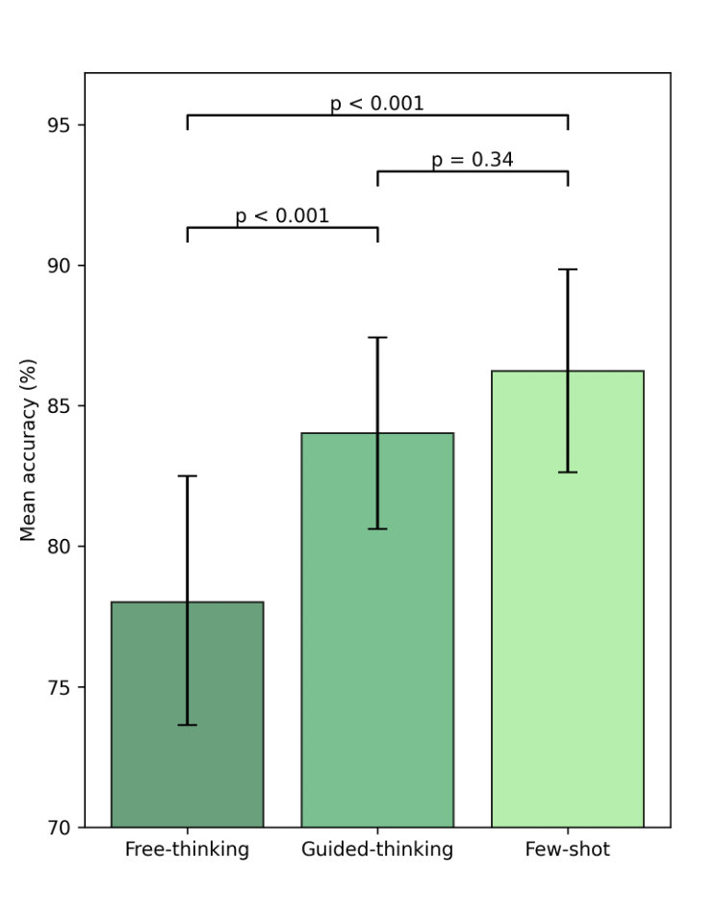
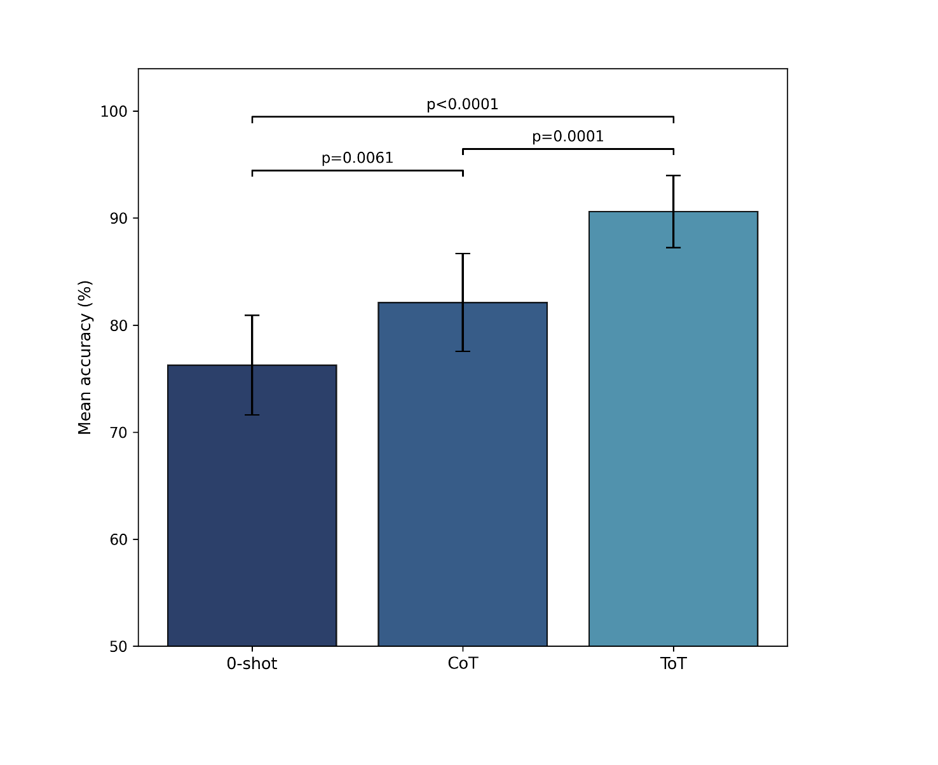
Improving large language models accuracy via Heart Team simulation: a prompt design analysis
Aim: Analyse and optimise prompt design to enhance LLM accuracy in complex medical decision management.
231 patients:
Results: prompt type
Prompting technique:
With severe aortic stenosis
Treatment proposed by the Heart Team:
1
0-shot
vs.
Free-
thinking
Guided-
thinking
vs.
1
ToT
vs.
Few-shot
prompting
Self-consistency
2
3
2
3
TAVI
(n = 168)
SAVR
(n = 50)
MEDICAL
(n = 13)
1
CoT
Multiple prompts compared:
3 types of prompts and 4 prompting techniques evaluated through 40 queries per patient's vignette
Primary endpoint: accuracy (proportion of recommendations matching the Heart Team decision)
Secondary endpoint: treatment invasieness
Total of 147,840 queries
The ToT prompt type, guided-thinking, and self-consistency significantly enhanced LLM decision accuracy, underscoring the crucial role of prompt design in LLM-driven clinical decision-making.

